Slide 1
Introduction to Programming (I)
Unit 1
Min-Chun Hu
CS, NTHU
anitahu@cs.nthu.edu.tw
The slides are modified based on the course slides of Prof. Shun-Ren Yang.

Slide 2
C Programming Language

Slide 3
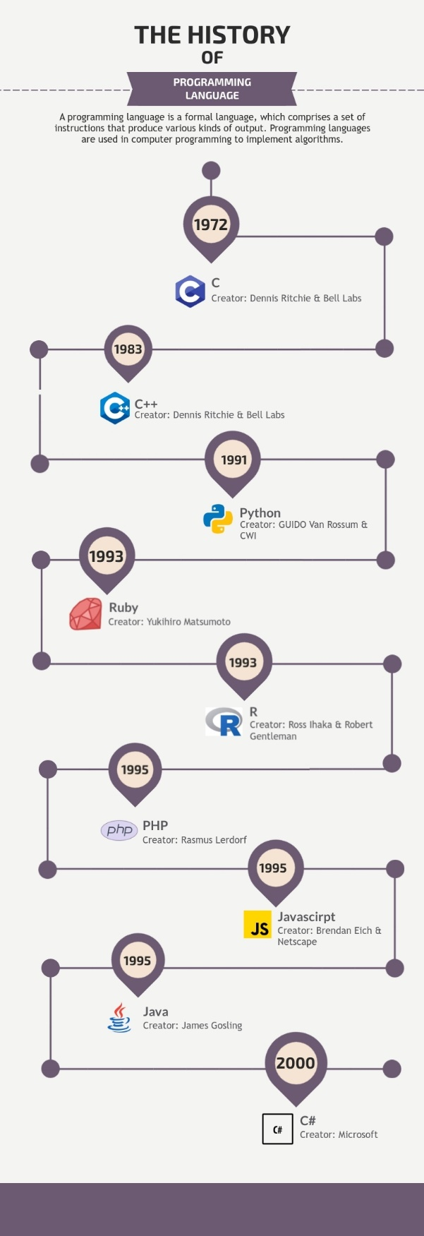
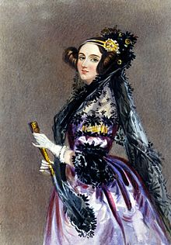
A History of Computer Programming Languages
https://www.informationisbeautifulawards.com/showcase/4348-a-history-of-programming-language
The first computer programming language was created by Ada Lovelace in 1883.

Slide 4
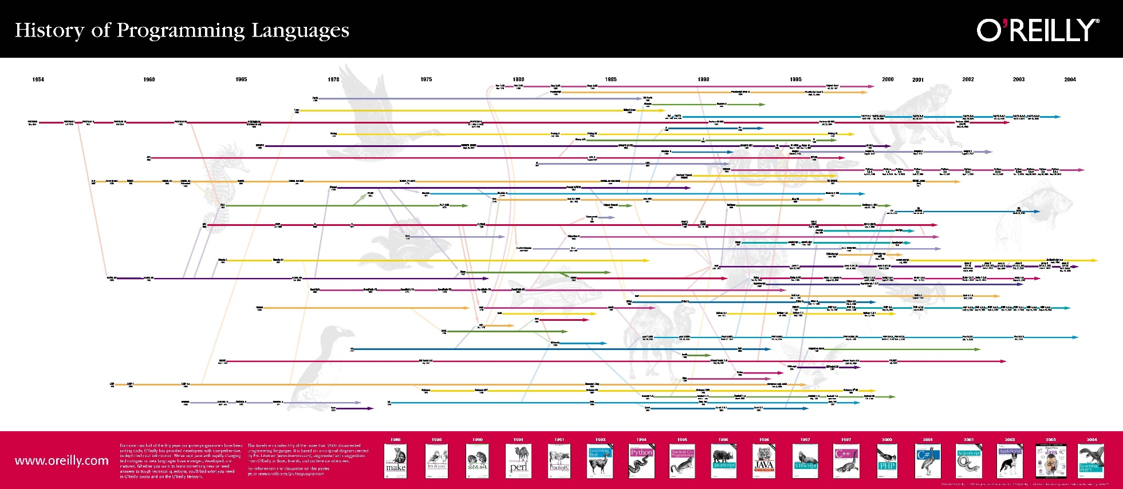
A History of Computer Programming Languages
[Ref] http://oreilly.com/news/graphics/prog_lang_poster.pdf

Slide 5
How Many Programming Languages Exist?
There are thousands of programming languages and new ones are created every year.
Few languages ever become sufficiently popular, but a professional programmer may use dozens of languages in a career.

Slide 6
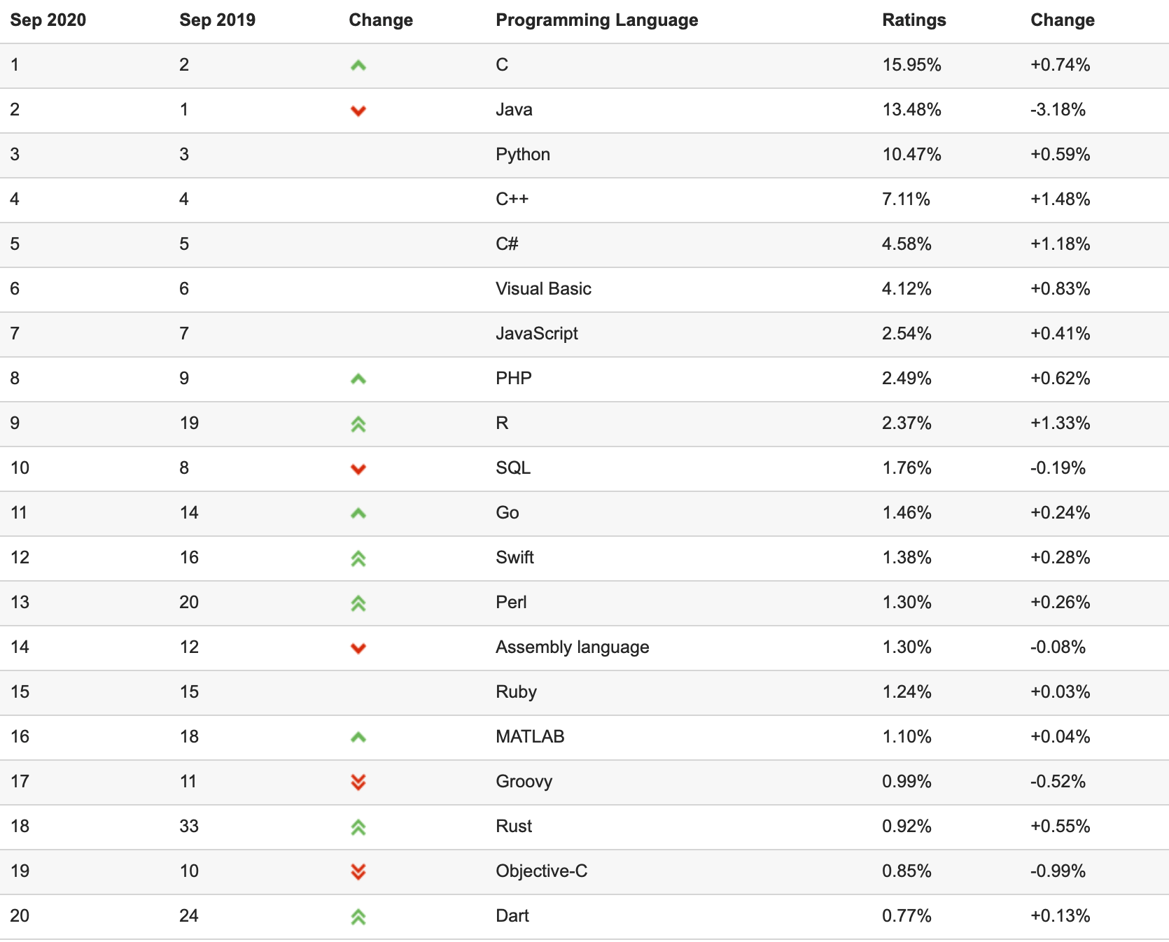
Popular Programming Languages
TIOBE Programming Community index.
To check whether your programming skills are up to date.
To make a strategic decision about what programming language should be adopted when starting to build a new software system.
[Ref] http://www.tiobe.com/index.php/content/paperinfo/tpci/index.html

Slide 7
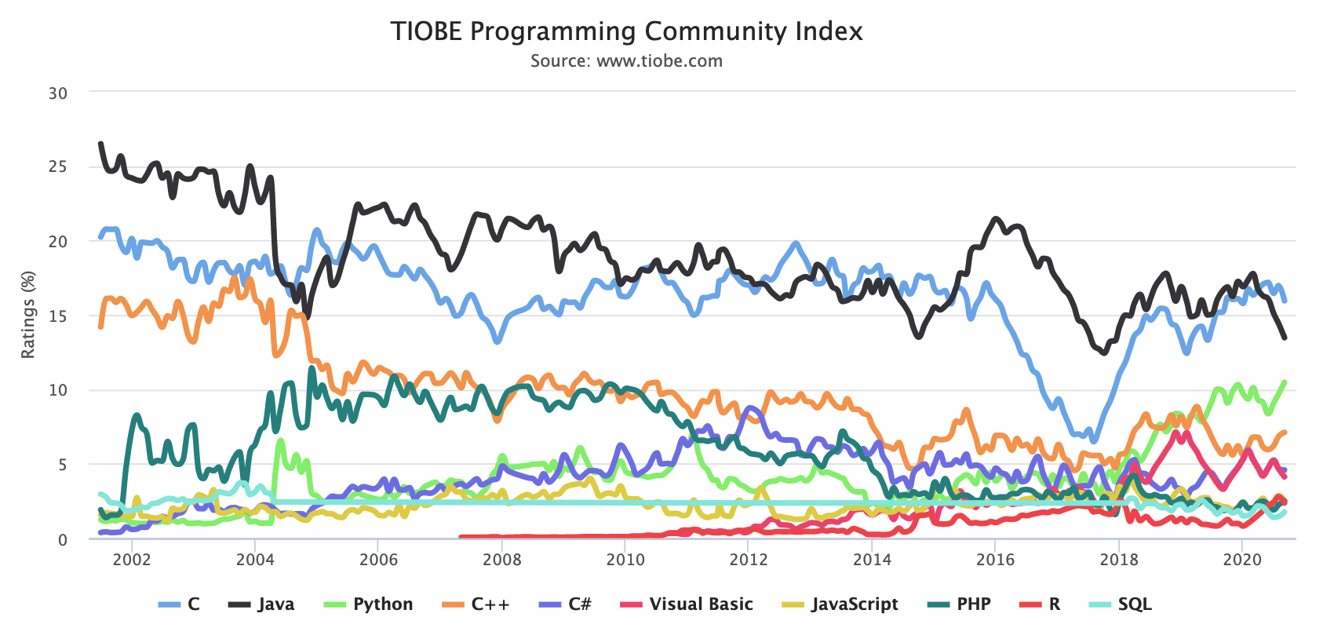
Popular Programming Languages

Slide 8
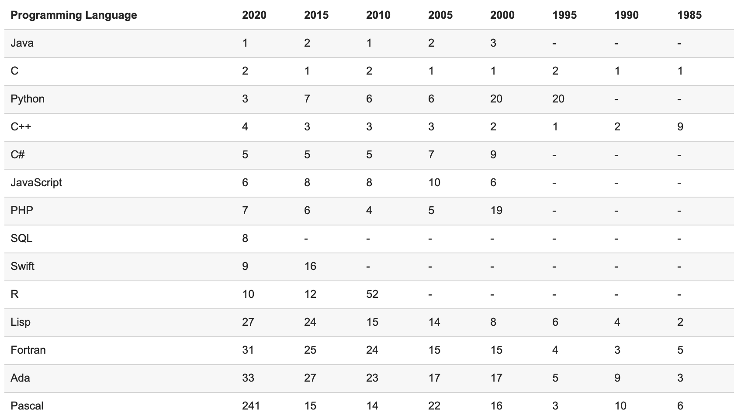
Popular Programming Languages
Very Long Term History
[Ref] http://www.tiobe.com/index.php/content/paperinfo/tpci/index.html

Slide 9
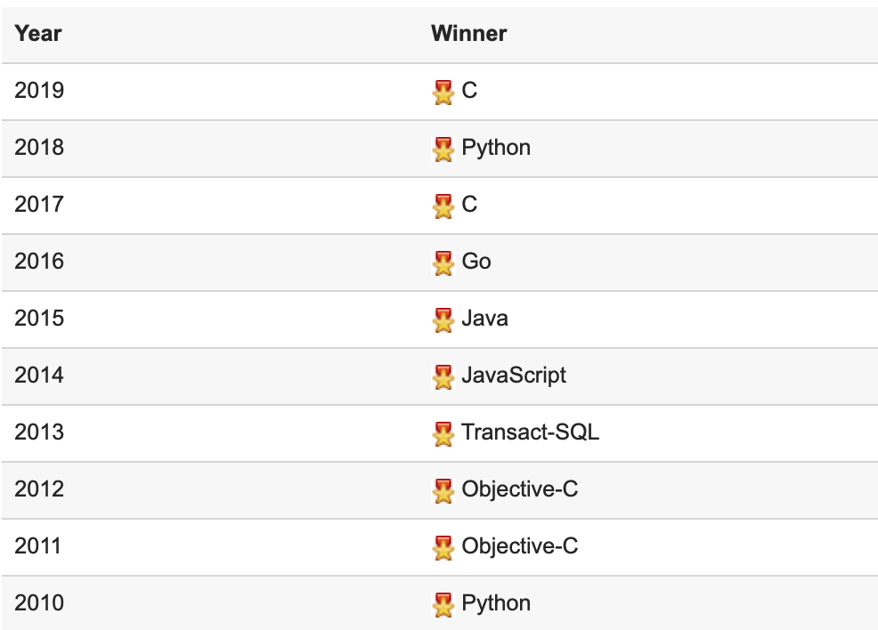
Popular Programming Languages
The hall of fame award is given to the programming language that has the highest rise in ratings in a year.
[Ref] http://www.tiobe.com/index.php/content/paperinfo/tpci/index.html

Slide 10
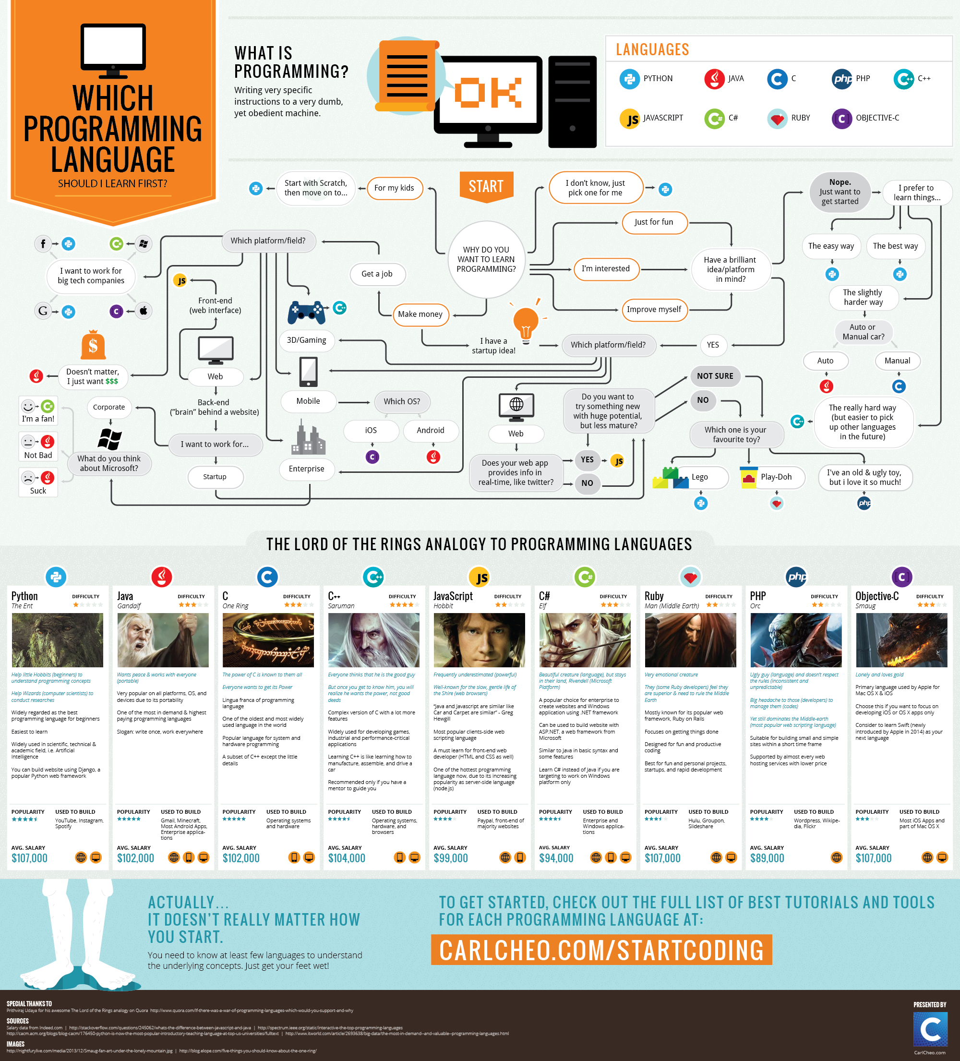
Which Language to Learn?
[Ref] http://carlcheo.com/startcoding

Slide 11
Which language to Learn?
[Ref] http://carlcheo.com/startcoding

Slide 12
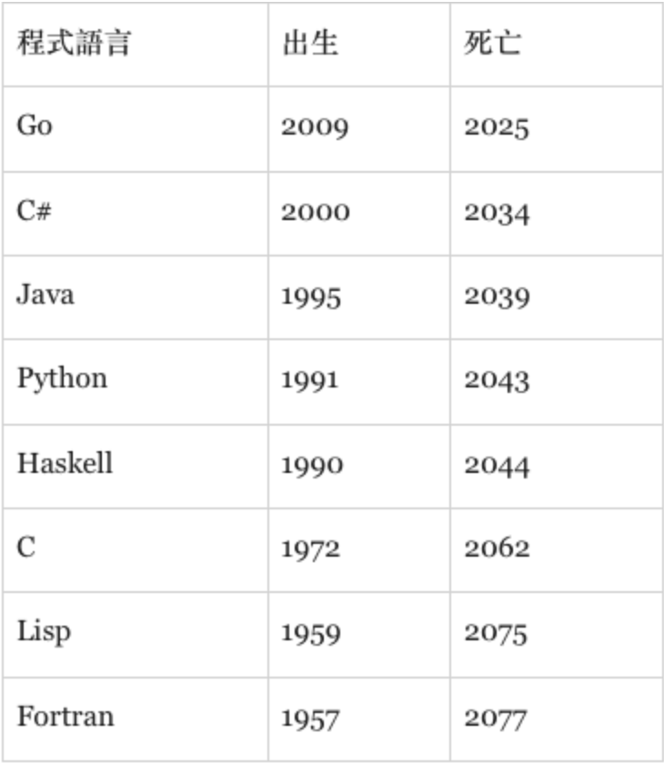
Which language can survive longer?
https://buzzorange.com/techorange/2017/08/29/lindy-on-programming/

Slide 13

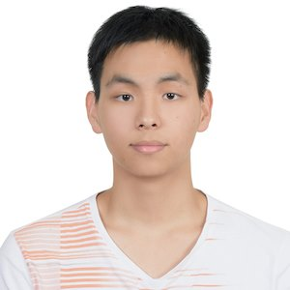
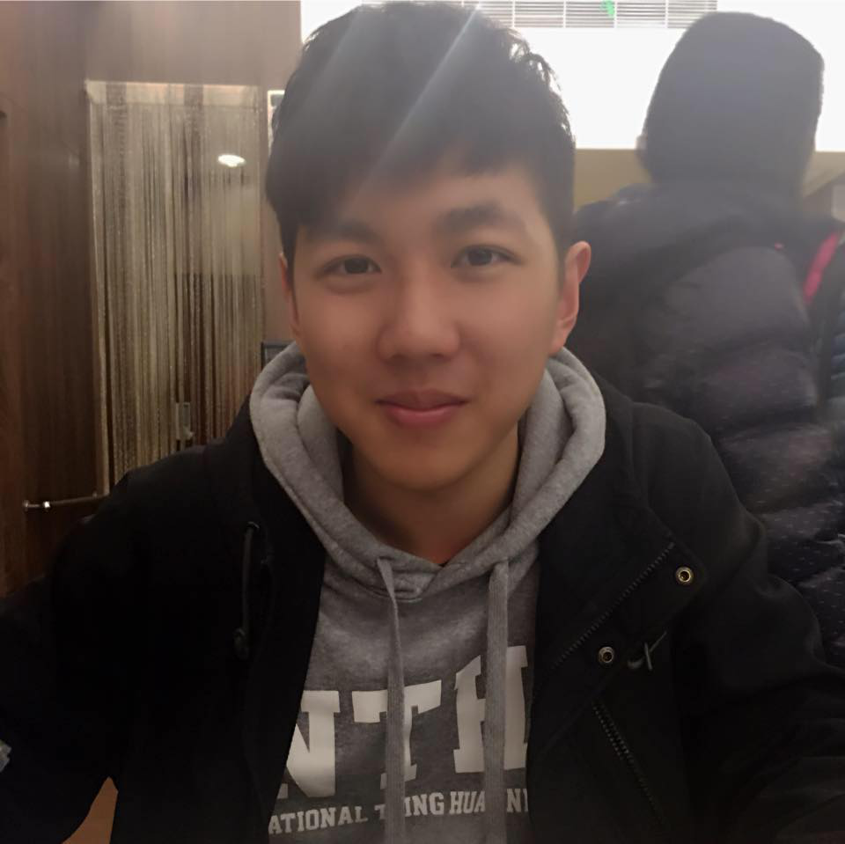
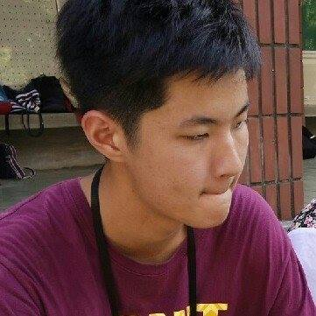

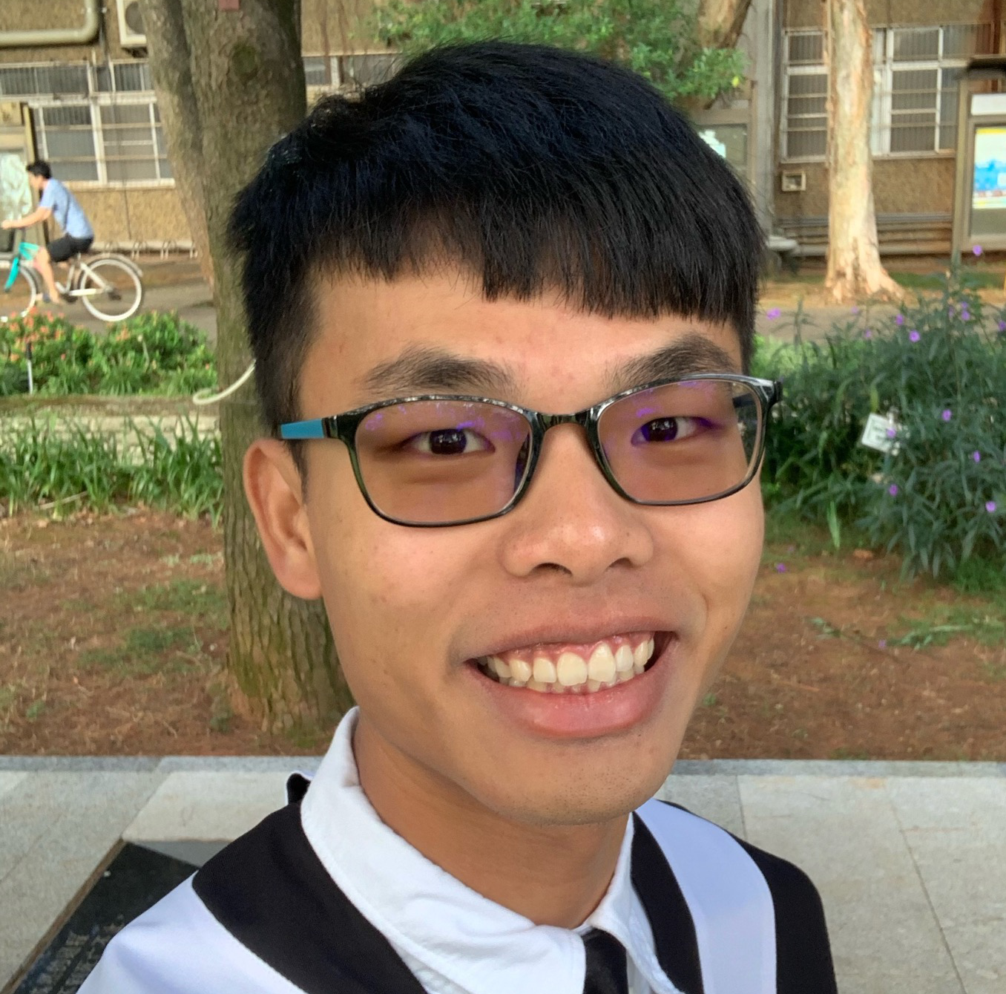
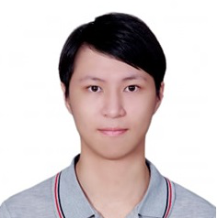


TA
Office Hour: TBA
李侑霖
古慶宸(English)
黃琮耀
張景翔
高鼎揚
張堂真
林庭葳
蔣立元
陳昱丞

Slide 14
Syllabus
Date | Course
9/14 | Syllabus & Introduction
Before Midterm (I) | Data and C Formatted Input/Output Operators, expressions, and Statements Control Statements: Looping, Branching Character I/O and Redirection Functions
11/2 | Midterm Exam on PC (I)
Before Midterm (I) | Recursion Arrays and Pointers String Functions File Input/Output Bit Manipulation
12/7 | Midterm Written Exam
12/14 | Midterm Exam on PC (II)
12/19 or 20 | Hackathon !
Before Final | Memory Management Structures The C Preprocessor and the C Library Advanced Data Representations
1/18 | Final Exam on PC
Grading
Online judge labs (15%)
every week (lab1 ~12)
The highest 10 scores among 12 labs
One written exam (10%)
Two midterm online exams (10% + 20%)
One final online exam (30%)
Final project (15%)

Slide 15
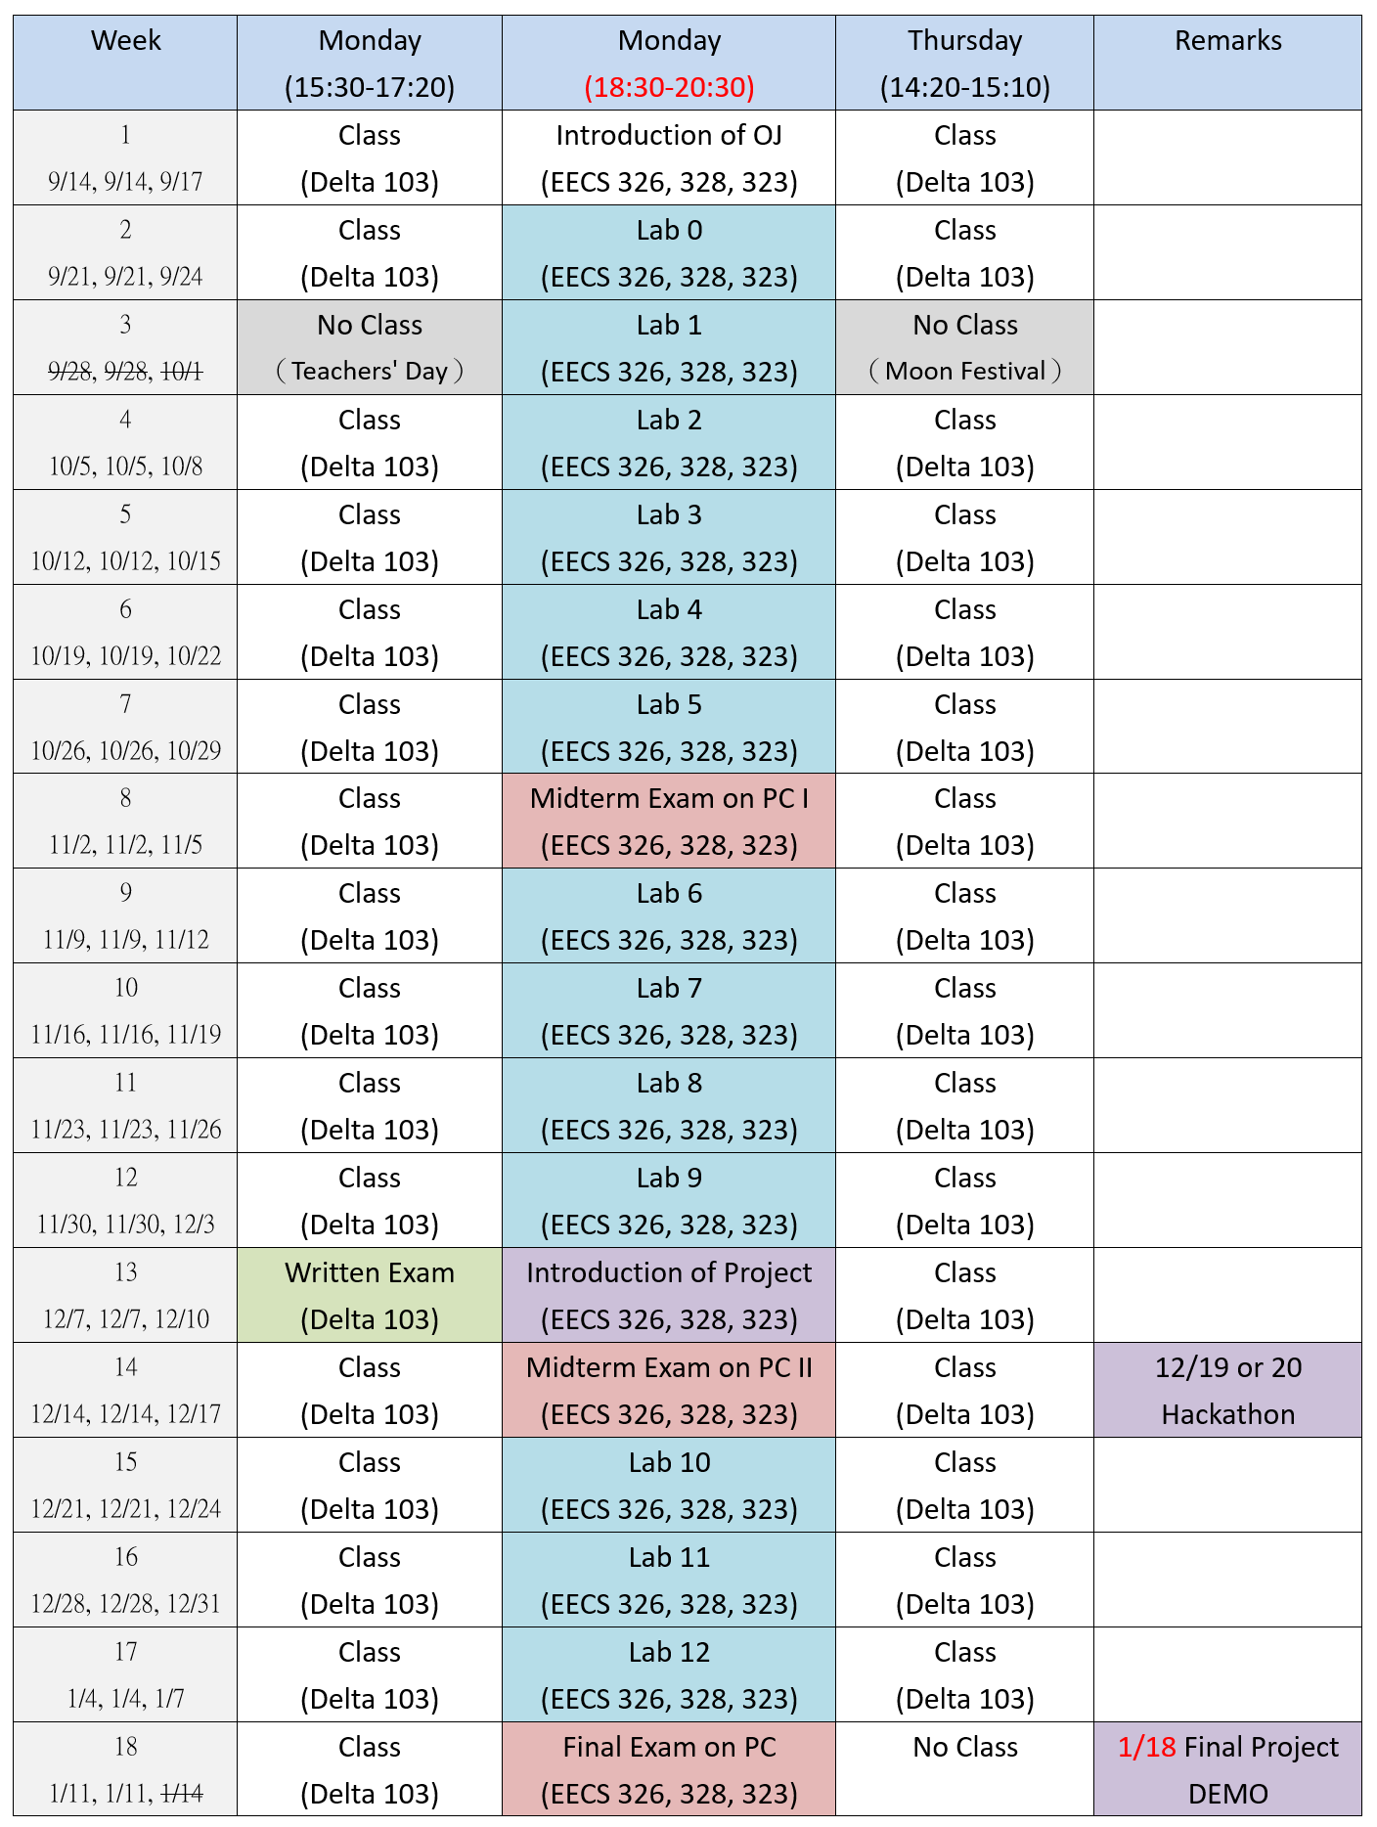
2020 I2P(I) Schedule

Slide 16



Course Q&A
Might do the roll call for bonus point
Take attendance?
Food?
Zzz…?

Slide 17
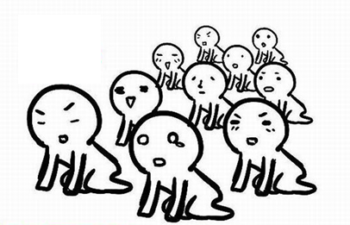
Be Responsible for Yourself
Cheating or plagiarism will result in zero score
➔ Final score=0
Under 60 ?
➔ See you next year ~
I will not reply any email of begging additional scores

Slide 18
Any Question?

Slide 19
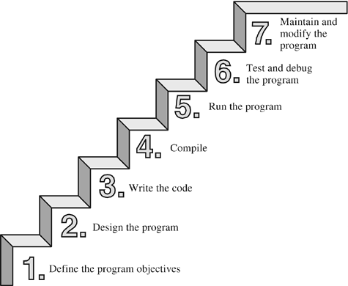
The Seven Steps of Programming

Slide 20
Compiler and Linker
Text editor
Compiler
converts your source code to machine language code (object code)
Linker
brings together object codes into the executable file
text editor
source code
hello.c
compiler (+ assembler)
object code
hello.obj
library code
linker
startup code
executable code
hello.exe

Slide 21
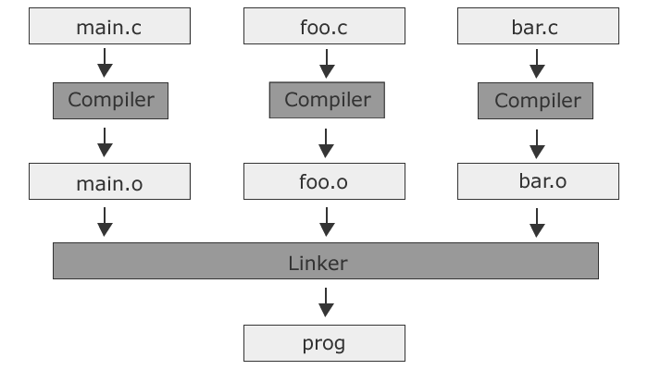
Compiler and Linker

Slide 22



Programming in Integrated Development Environments (IDEs)
Open a new file
Write a “Hello world!”program
Compile the program
Run the program
Debug the program

Slide 23
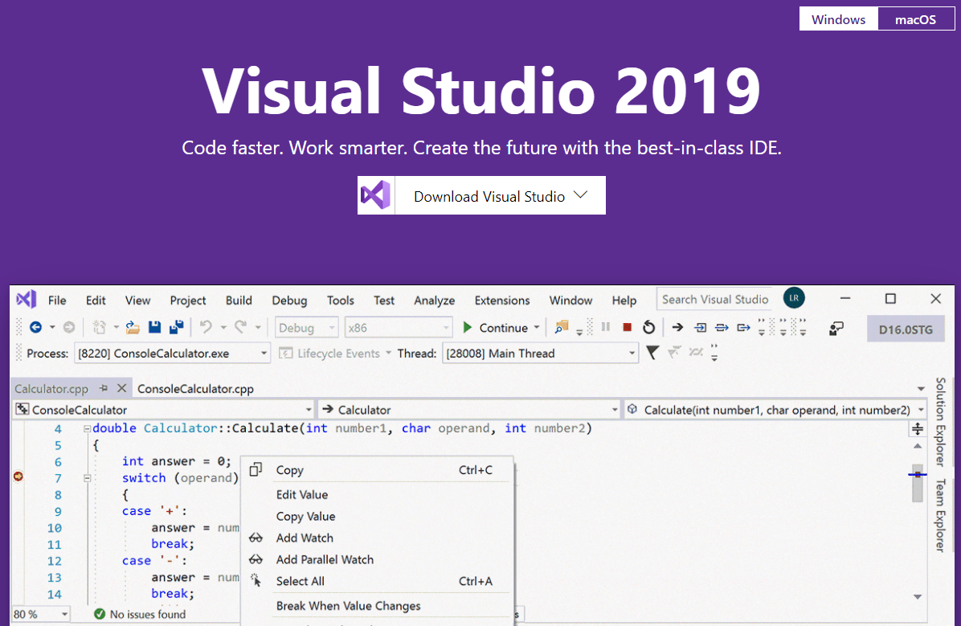
Install C++ Support in Visual Studio
Notes:
https://visualstudio.microsoft.com/vs/
https://docs.microsoft.com/zh-tw/cpp/build/vscpp-step-0-installation?view=vs-2019

Slide 24
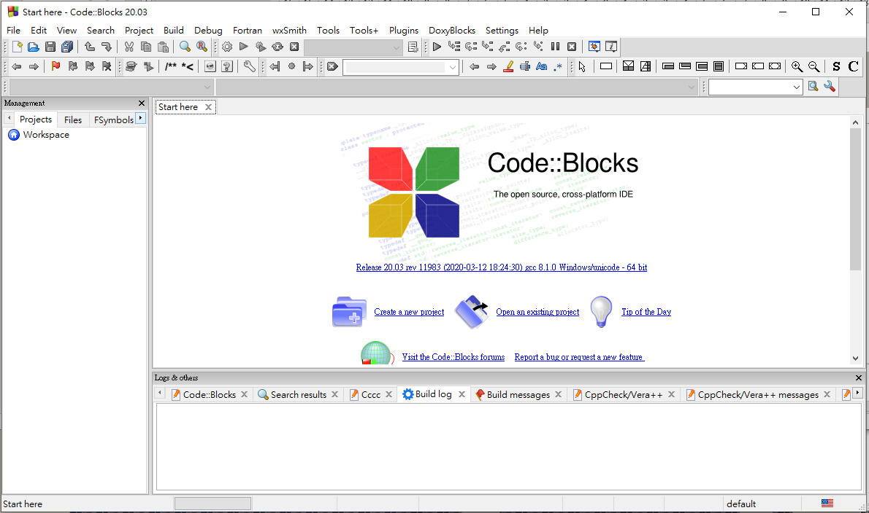

Slide 25
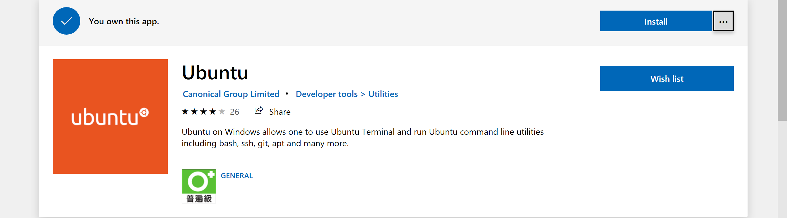
Coding Environment for C/C++
Windows:
Choice 1: IDEs with both compiler and editor
Choice 2: Cygwin (allows programs of Unix-like systems to be recompiled and run natively on Windows)
Remember to select gcc (compiler) and vim (editor) related items while installing
Choice 3: MinGW (compiler), remember to set Environment Variables
Choice 4: Bash on Windows
Mac:
install homebrew
ruby -e "$(curl -fsSL https://raw.githubusercontent.com/Homebrew/install/master/install)"
brew install gcc
gcc-9 –v (check gcc version)
Note: "gcc -v" will use default clang compiler on mac instead of the gcc we install.
Notes:
Homebrew is a free and open-source software package management system that simplifies the installation of software on Apple's macOS operating system and Linux.
Cygwin allows programs of Unix-like systems to be recompiled and run natively on Windows

Slide 26
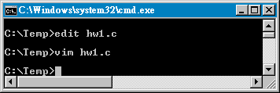
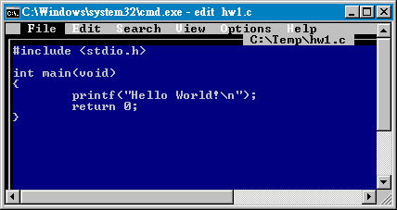
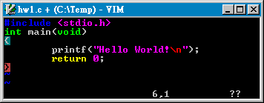
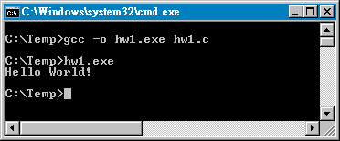
Compile in the Command Line

Slide 27
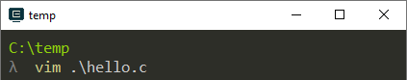
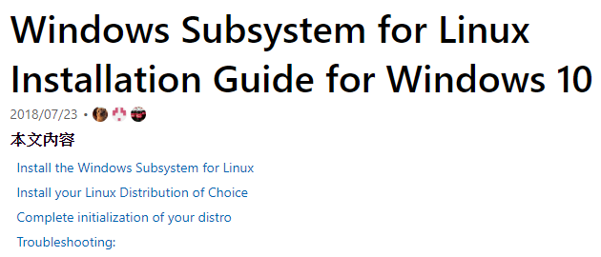
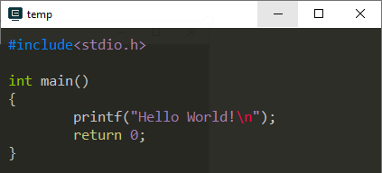
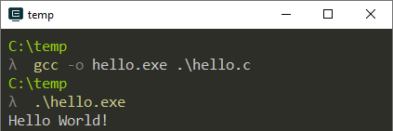
Compile in the Command Line (on Windows)
Notes:
Manually download Windows Subsystem for Linux distro packages
https://docs.microsoft.com/zh-tw/windows/wsl/install-manual

Slide 28
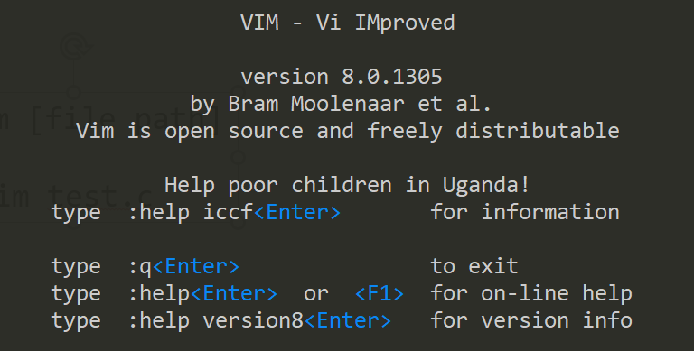
Vim
Vi Improved

Slide 29
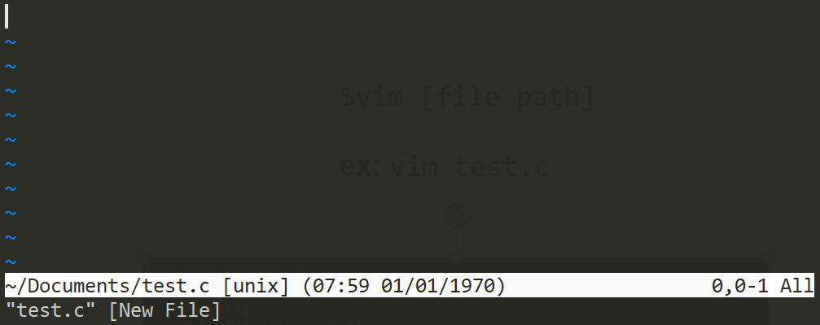
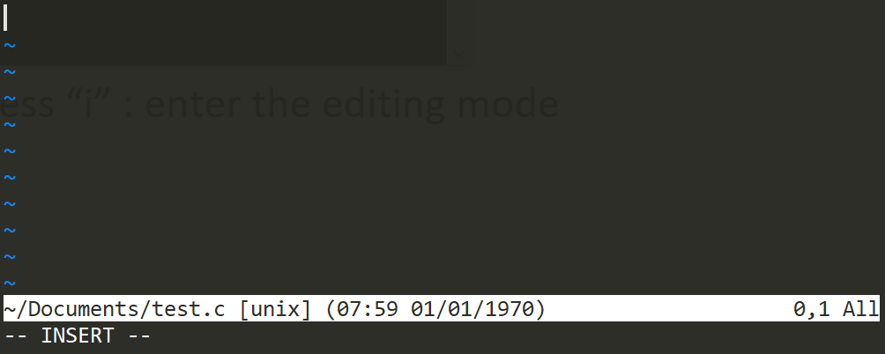
Open Vim
$vim [file path]
ex: vim test.c
Press “i” : enter the editing mode

Slide 30
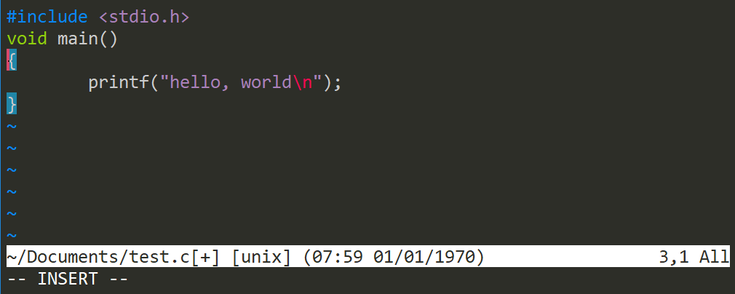
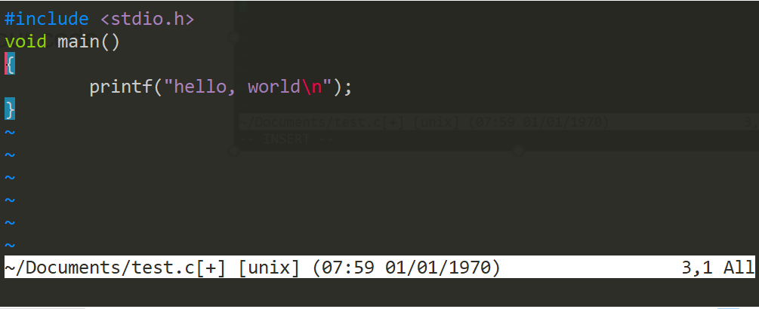
Basic Operation in Vim
Edit your code
Press “Esc” : exit the editing mode

Slide 31
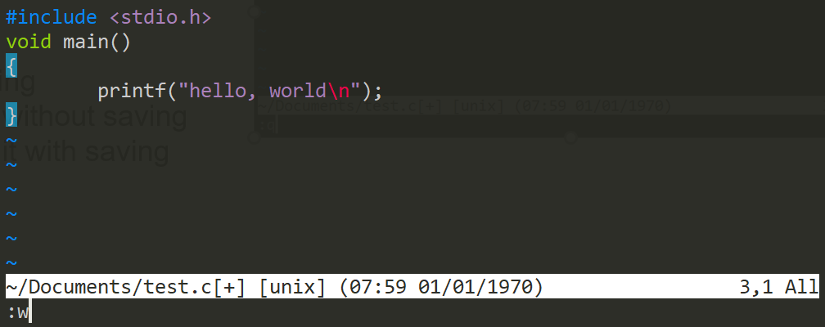
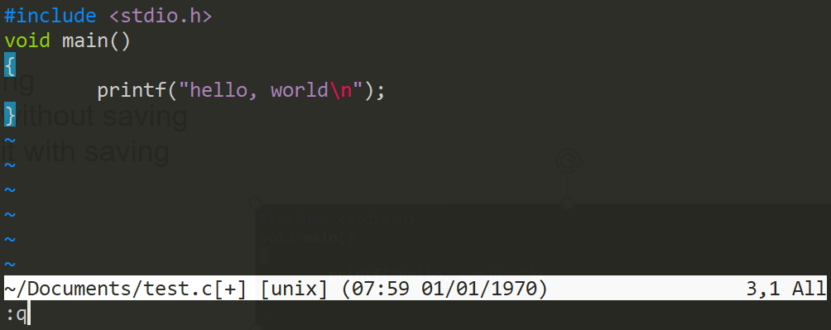
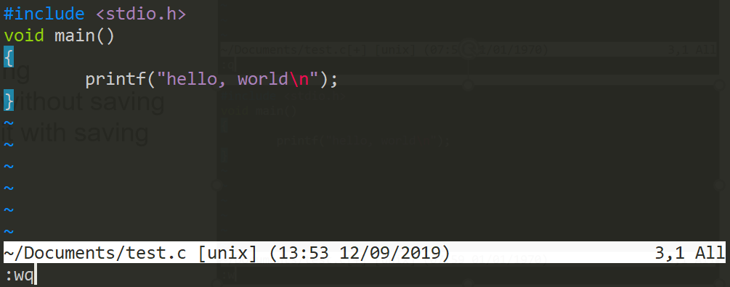
Basic Operation in Vim
Input
“:w”: saving
“:q”: quit without saving
“:wq”: quit with saving

Slide 32
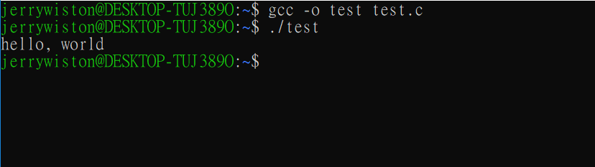
Compile and RUN
Compile source code to executable code
Run the executable code

Slide 33
C-Program Examples
Ex. 1: Print a string
Ex. 2: Print the sum of 1234 and 5678
Ex. 3: Demonstrate the formatted outputs of integer and floating point numbers
Ex. 4: Read in an integer x from the keyboard, and print the integer x+1
Ex. 5: Read in two integers x and y from the keyboard, and print their sum
Ex. 6: An example that contains multiple functions

Slide 34
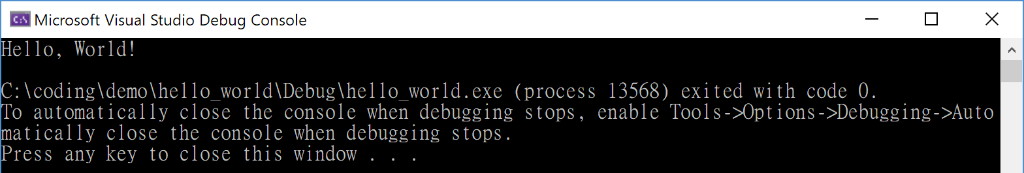
Ex. 1: Print a string
#include <stdio.h>
int main(void)
{
printf("Hello, World!\n");
return 0;
}
Note:
main function: The entry of a C program
Return type: int for “integer” data type
Parameters/arguments: void for “empty”
A statement ends with a semicolon ‘;’.
“…”: a C string
Header files:
#include <stdio.h>
returns 0 to OS to tell the OS that your program executed successfully

Slide 35
Ex. 2: Print the sum of 1234 and 5678
/* Can you understand the previous example program? */
// Let’s try one more!
#include <stdio.h>
int main(void)
{
printf("??\n", ?);
return 0;
}
Note:
Program comments
/* */ or // (C99 or C++ one-line comment)
Ignored by the compiler
For human only
formatted output
%d for an integer

Slide 36
Variable
int a = 20;
datatype
variable name
value
Reserved memory for variable a
a
← Variable name
20
← Value of a
0x7fff5694dc58
← Address of a
RAM

Slide 37
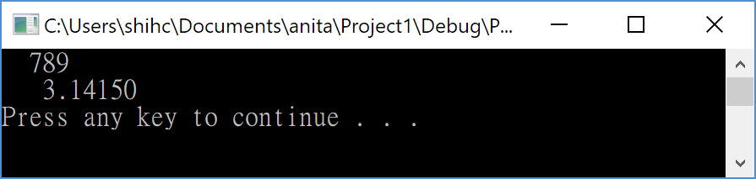
Ex. 3: Demonstrate the C formatted outputs
#include <stdio.h>​
int main(void)​
{​
int x; // integer 32-bit​
double y; // 64-bit double precision floating point number​
x = 789;​
y = 3.1415;​
// formatted output​
printf("%5d\n", x); // decimal​
printf("%10.5f\n", y); // floating point​
return 0;​
}​

Slide 38
Arithmetic Operators in C
Assume variable A holds 10 and variable B holds 20, then:
Operator | Description | Example
+ | Adds two operands | A + B will give 30
- | Subtracts second operand from the first | A - B will give -10
* | Multiplies both operands | A * B will give 200
/ | Divides numerator by de-numerator | B / A will give 2
% | Modulus Operator and remainder of after an integer division | B % A will give 0

Slide 39
Ex. 4: Read in an integer x from the keyboard, and print the integer x+1
#include <stdio.h>
int main(void)
{
int x=0;
printf("Input a number x:\n");
scanf("%d", &x);
printf("x+1=%d\n", x+1);
return 0;
}
Note:
Variable declaration
Normally, at the beginning of a function
int x -> x is a variable of “integer” data type
The first character of a variable name must be a letter or an underscore. The other characters can also be digits
Assignment statement
The = operator in C is used for assignment

Slide 40
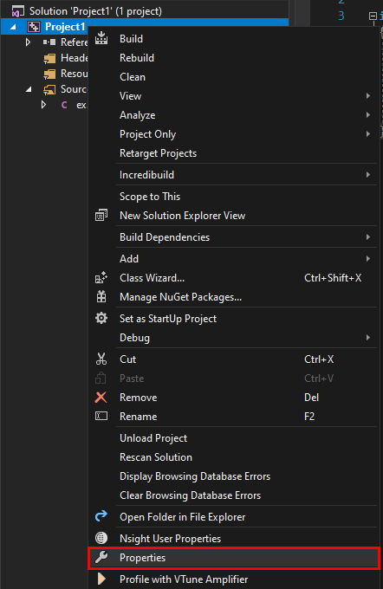
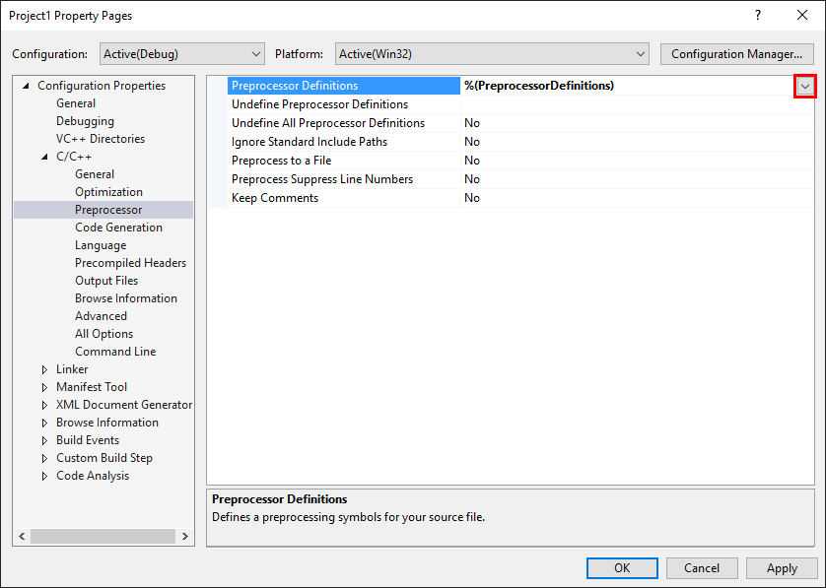
Problem might occur when building in VS
solution

Slide 41
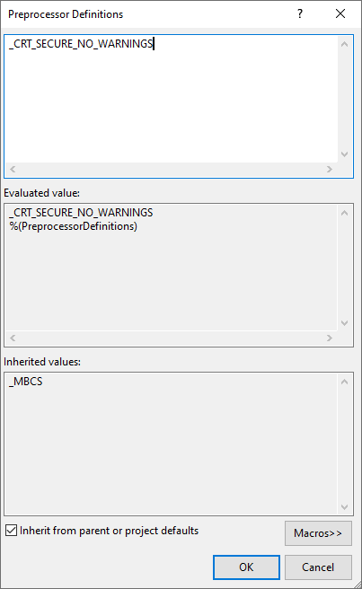
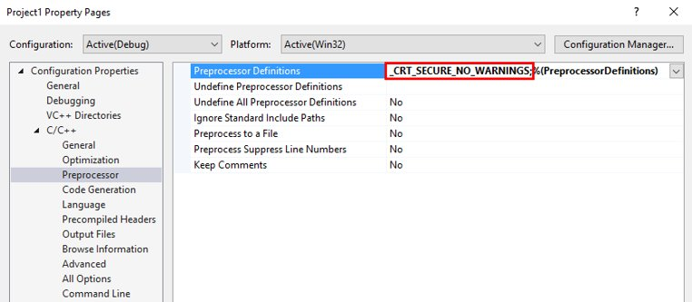
Problem might occur when building in VS (Cont.)

Slide 42
Ex. 5: Read in two integers x and y from the keyboard, and print their sum
#include <stdio.h>
int main(void)
{
int x, y;
printf("Input a number x:\n");
scanf("%d", &x);
printf("Input a number y:\n");
scanf("%d", &y);
printf("x + y = %d + %d = %d\n", x, y, x + y);
return 0;
}

Slide 43
Ex. 6: An Example that Contains Multiple Functions
#include <stdio.h>
int print(void);
int square(int);
int main(void)
{
print();
return 0;
}
int print(void)
{
printf("%d\n", square(5));
return 0;
}
int square(int x)
{
return x * x;
}
Note:
Function declarations (or prototyping) vs. function definitions
The sequential execution of functions

